Slide 1

Live long learning
by G.A.B.S

Slide 2


You´re done with highschool and NOW?

Slide 3


Problems
Overwhelming information

Slide 4

What is the necessity?
The massive amount of information it‘s overwhelming and could cause misinformation.
Our solutions is an easy, accessible, organized information.

Slide 5




you are a few steps away from opening an account.
you are a few steps away from opening an account.
Add Image
You are a few steps away from opening a SWITCH edu-ID account! Insert the code sent to your e-mail
Verified!
SWITCH edu-ID
192T736Y947P
You are a few steps away from opening a SWITCH edu-ID account! Insert the code sent to your e-mail
First Name
Last Name
E-mail
*
*
*
*
*
*
*
*
Password
Verification
Verification
Confirm password
Submit
Account
Research
Favorite
Notifications
Account
Research
Favorite
Notifications
Account
Research
Favorite
Notifications

Slide 6
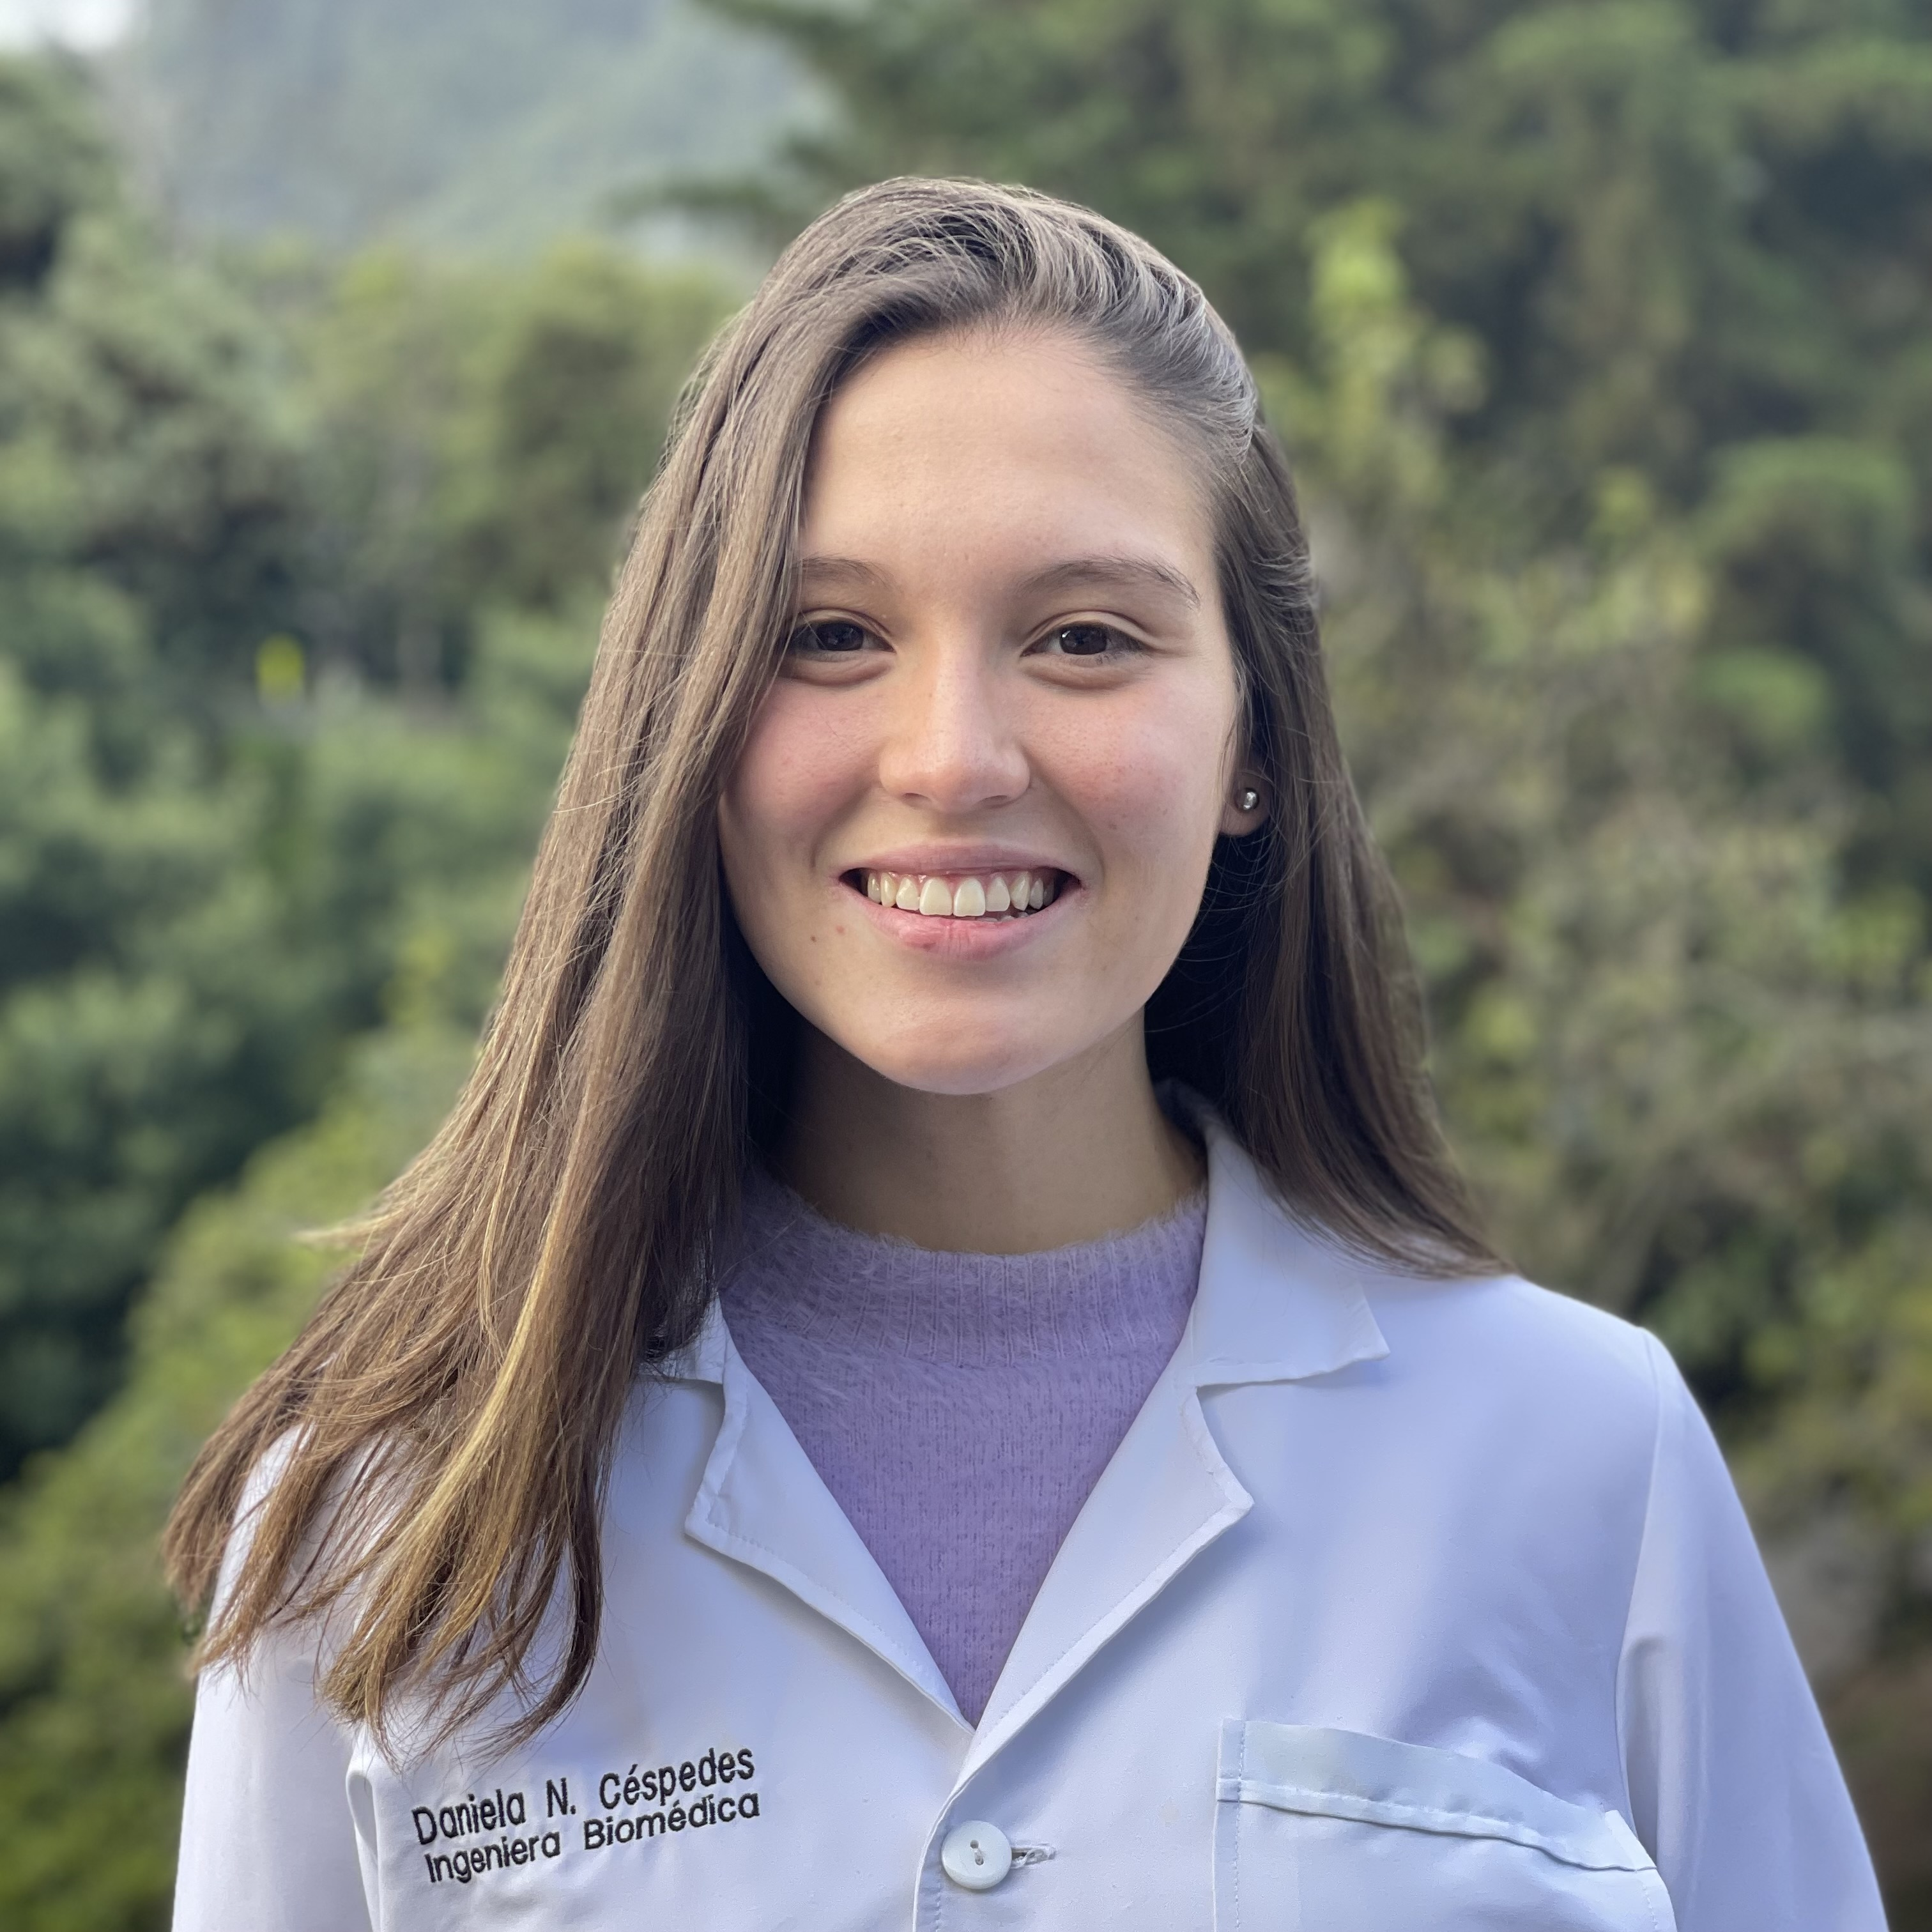


Additional information
Add Image
Search…
Search…
Interest
Academic
Sports
Nationality
Technical
Disciplines
(?)
Sex F
Budget
Level of studies HS
Continent
Language proficiency
Country
English
Spanish
German
Adjust info
Account
Research
Favorite
Notifications
Account
Research
Favorite
Notifications
Account
Research
Favorite
Notifications

Slide 7

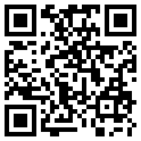

Student feedback
Student feedback
Search…
Relevant Information
Requirements
University of St. Gallen
Low Inter High
CV
C1 certificate
Ranking
8 (QS)
HS GPA
Motivation letter
ETH
Time
4 years
University of Beern
Diversity
38%
Letters of recommendation
Innovation
1° world
Price (life+semester)
+2000CF
Start your application
University of Geneva
Requirements
CV
C1 certificate
Account
Research
Favorite
Notifications
Account
Research
Favorite
Notifications
Account
Research
Favorite
Notifications

Slide 8


Favorites
Notification
Deadline on 30.4 for ETH
Last chance to apply!
ETH
EPFL
Deadline on 15.4 for EPFL
Check your application!
University of Geneva
Event
ETH is having an open-door day, Tomorrow.
Remove from favorites
Account
Research
Favorite
Notifications
Account
Research
Favorite
Notifications

Slide 9


Mutual
Benefits

Slide 10


Discover and share your experience

Slide 11

Start with what we know
Expand step by step

Slide 12





LIVE LONG

Slide 13
YOUR PASSION, ONE SEARCH AWAY
VIELEN DANK

